Slide 1
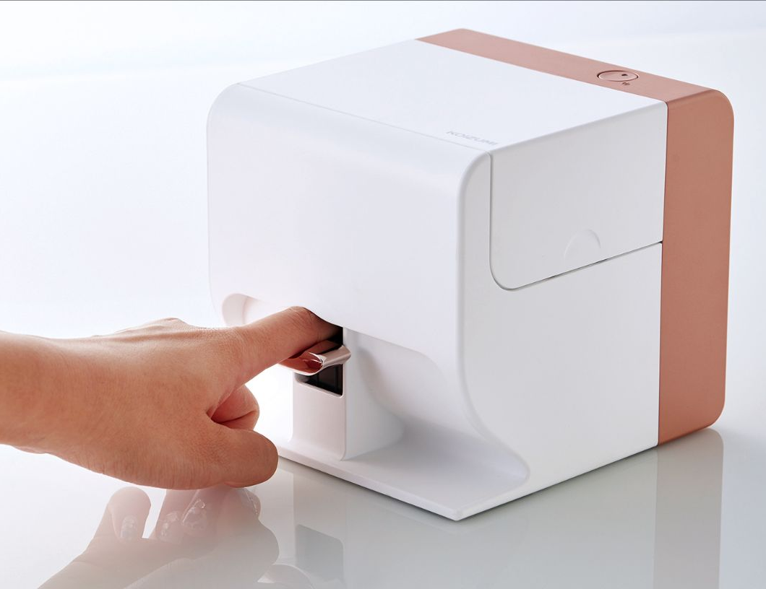
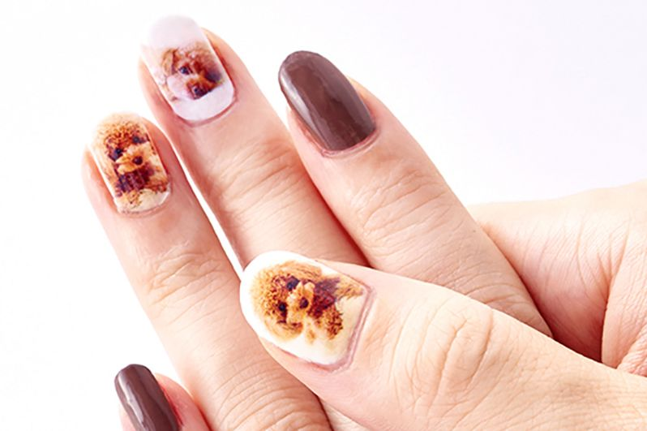
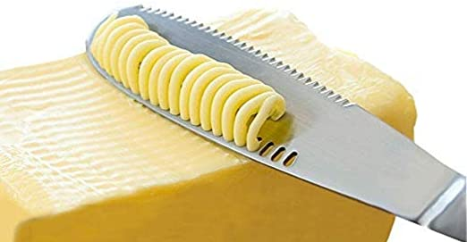
Inventions
necessity is the mother of invention
reinvent the wheel

Slide 2
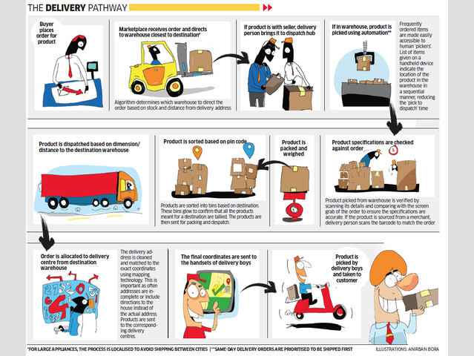
a cog in the machine – an insignificant member of a huge organisation or system
a well-oiled machine – an organisation that operates smoothly
acid test – a test of something’s value or success
as bright as a button – very intelligent
bells and whistles – extra features and trimmings
cutting edge – advanced and innovative
in tune with – in agreement or harmony with someone or something
it’s not rocket science – it’s not difficult
on the ball – alert
on the same wavelength – to be in agreement/to have similar views and ideas
to blow a fuse – to lose your temper
to button your lip – to stay quiet
to get your wires crossed – to have a misunderstanding
to have something down to a science – to have perfected something through routine and repetition
to hit the panic button – to panic or take emergency measures
to know what makes someone tick – to know what motivates someone
to pull the plug – to prevent something from continuing or happening
to push someone’s buttons – to provoke someone
to reinvent the wheel – to waste time and effort creating something that already exists
to run out of steam – to lose enthusiasm
Find 3 Random objects online and link them together

